Slide 1
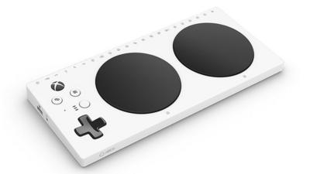
Text-to-Speech
Adventure
Mujeeb Adelekan
Spring 2021

Slide 2
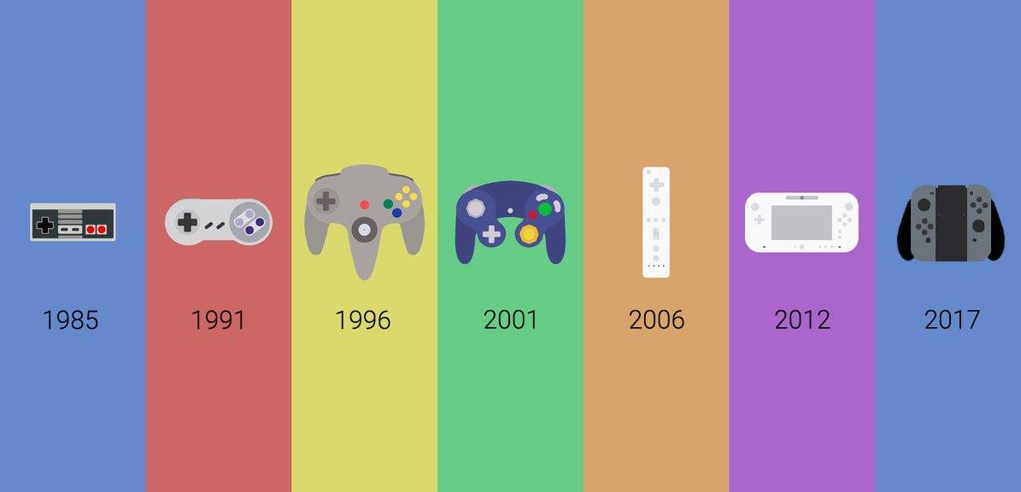
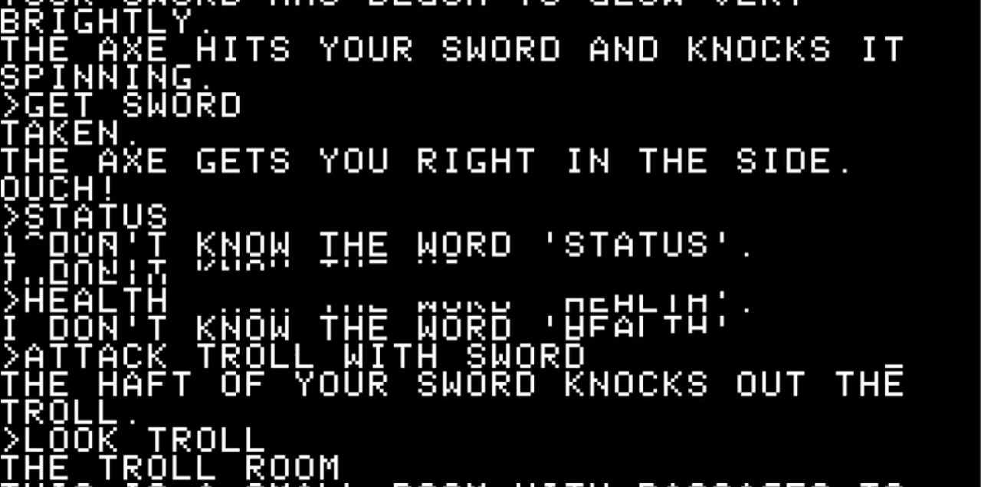
Problem, MOTIVATION, AND SOLUTION
PROBLEM: Importance of accessibility in HCI
HCI is central to gaming
MOTIVATION: Sensory and motor needs often ignored
Alternative methods of controlling video games
SOLUTION:
Text Adventure
  Style of Zork (1979)
Text-to-Speech Program to assist blind players
Both sighted and visually impaired players enjoy the same game
Options will be read out loud

Slide 3
Tools and Languages
Written in C#
Visual Studio Community 2019
Microsoft SQL Server Management Studio 2019
Developed on a Windows 10 machine
  HP Pavilion Laptop 15z-cs100
User requirements:
  Access to a Windows machine
  Basic motor skills and hearing ability
  Verbal English comprehension
  Developed spatial reasoning
  Have audio output (speaker or headphones)

Slide 4
Functionalities
The system will:
  Display text on screen
  Read text aloud for visually impaired or blind players
  Read all actions the player can take
  Allow the user to “scroll” through the options
  Repeat a selected option so the user can confirm their choice
  Take keyboard input (F, J, and Space Bar)
  Store an action log that keeps a record of the user’s actions and the results of those actions
  Store conditions and text descriptions in a database
  Store unique data for each room (Room description, room name, Array of exits
The user will:
  Listen to an audio description of the scenario
  Press Space to relisten to the description.
  Press F and J to scroll through the options
  Press Space to select an option
  Press Space a second time to confirm a selected option

Slide 5
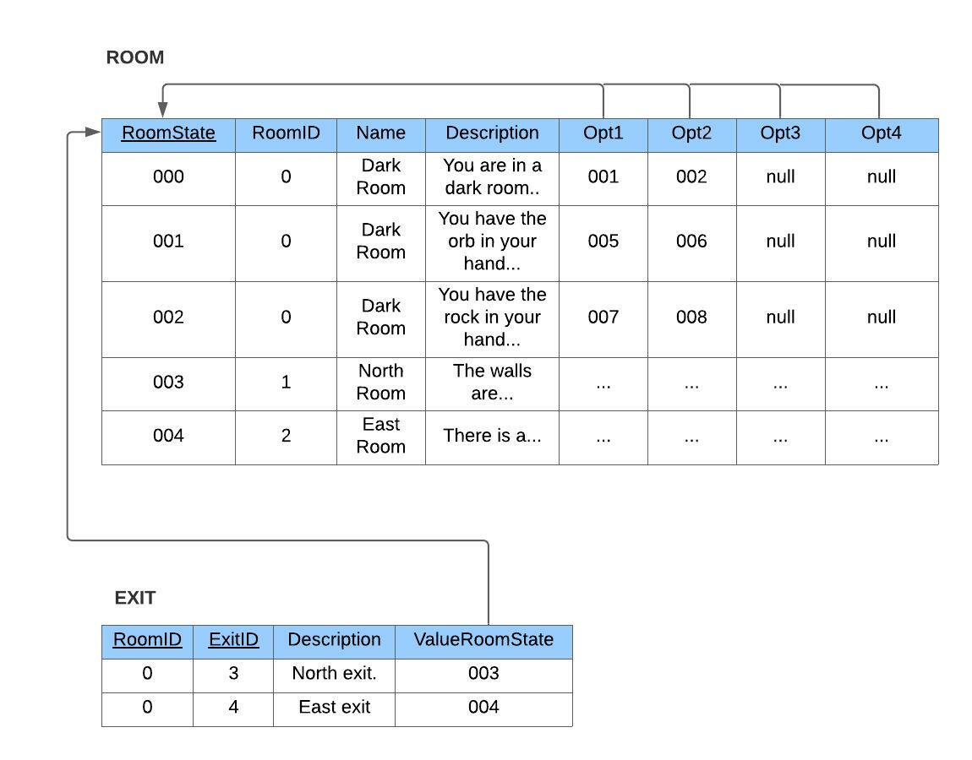
DATA STRUCTUREs
Room Database:
With ROOM Table
RoomState (key)
RoomID
Name
Description
Opt1, Opt2, Opt3, Opt4
and EXIT Table
Room ID, Exit ID,
Description,
ValueRoomState

Slide 6
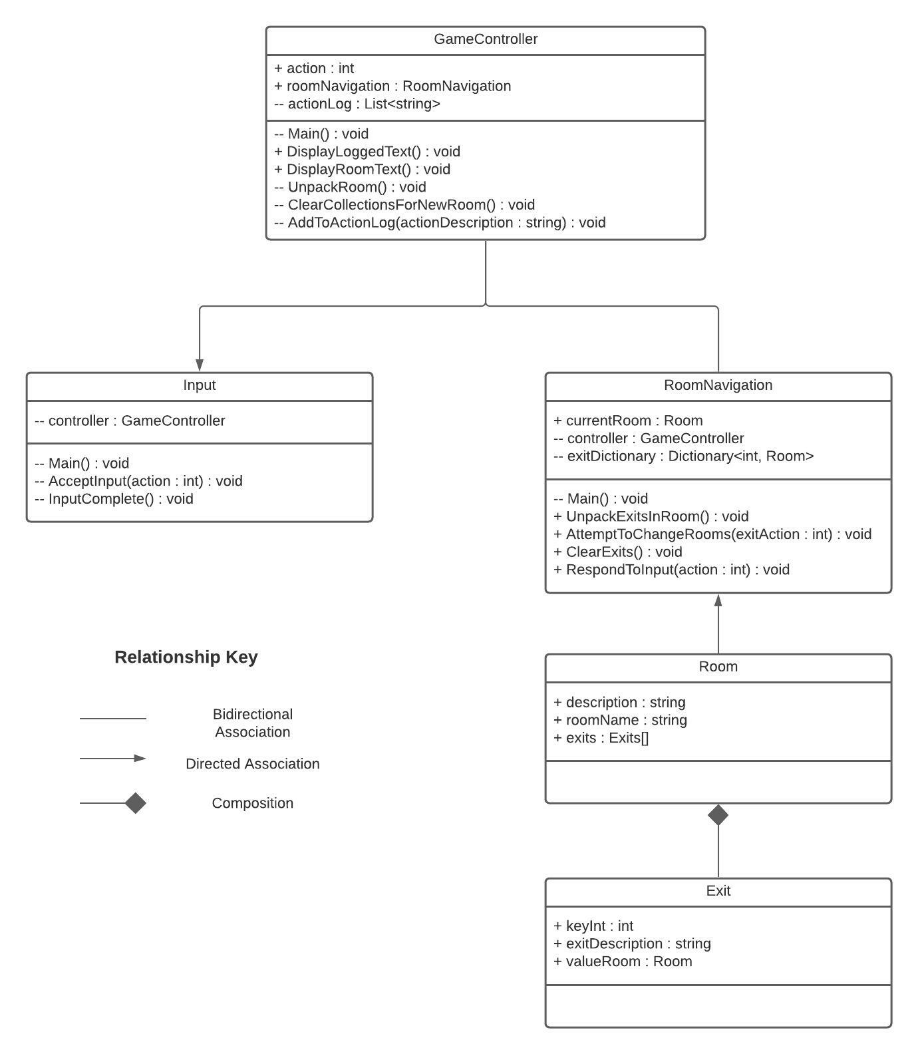
System structure
System Modules (Classes):
GameController
Input
RoomNavigation
Room
Exit

Slide 7
DRAFT SCREEN: Start OF GAME: THE DARK ROOM
The following screens hold placeholder descriptions of scenarios in the games.
The program will do the following:
Read the description aloud
Read all the options (e.g., “Your options are 1) pick up orb, 2) pick up rock, 3) Go through the exit in front of you, 4) Go through the exit on the right”)
Ask the user to hit F or J key to start scrolling through the options, and if the user wants to choose an option, pressing the Space key
  Each option will be read aloud when “highlighted”
When the Space key is pressed, tell the user to either hit Space to confirm or hit F or J to return to scrolling.
You are in a dark room with an orb, a rock, and two exits: one in front of you, and another to your right
Pick up orb
Pick up rock
Go through the exit in front of you
Go through the exit on the right

Slide 8
DRAFT SCREEN: result of action 1
The player chose the third option (“go through the exit in front of you”), so the program outputs the text description associated with that option
The program will do the following:
Update the screen with the action the user has taken, the new room description, and the new actions the user can take.
Read the description aloud
Read all the options (e.g.; “Your options are I) go through the front exit, II) back exit, III) left exit, or IV) right exit”)
Ask the user to hit F or J key to start scrolling through the options, and if the user wants to choose an option, pressing the Space key
  Each option will be read aloud when “highlighted”
When the Space key is pressed, tell the user to either hit Space to confirm or hit F or J to return to scrolling.
> Go through the exit in front of you
The walls are covered in thick, coarse moss. There are four exits: one in front, one behind, one to your left, and one to your right.
Go through the front exit
Go through the back exit
Go through the left exit
Go through the right exit

Slide 9
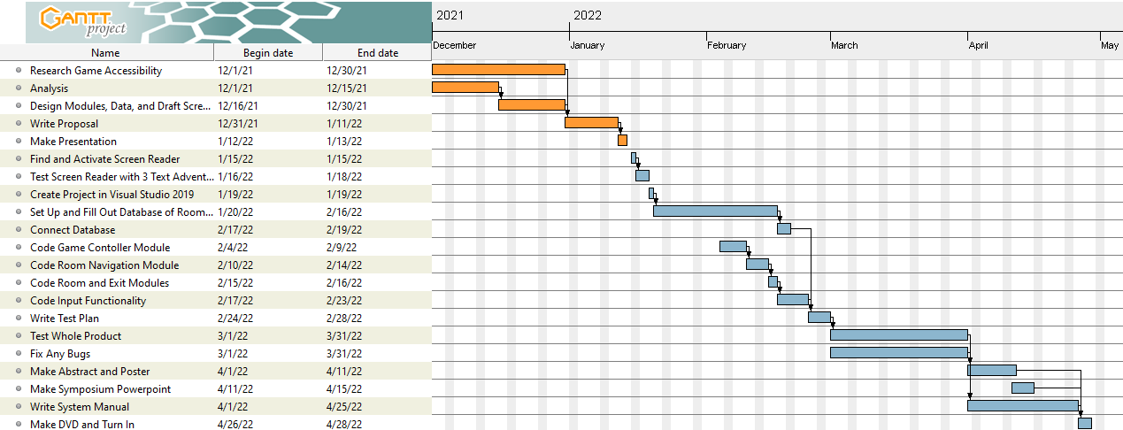
PROGRESS

Slide 10
PROGRESS (cont.)
WHAT I COMPLETED
WHAT I WILL HAVE DONE
Researched Game Accessibility
Performed Analysis
Designed Modules, Data, and Draft Screens
Wrote Proposal
Made Updated Presentation
Find and Activate Screen Reader
Test Screen Reader with 3 Text Adventures
  Zork I
  Seastalker
  The Hitchhiker’s Guide to the Galaxy
Create Project in Visual Studio 2019
Set up and Begin Filling out the Database

